Slide 1


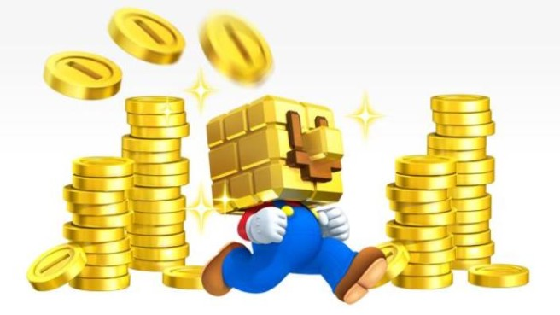

Gambling I
Produced by Dr. Mario
UNC STOR 390

Slide 2
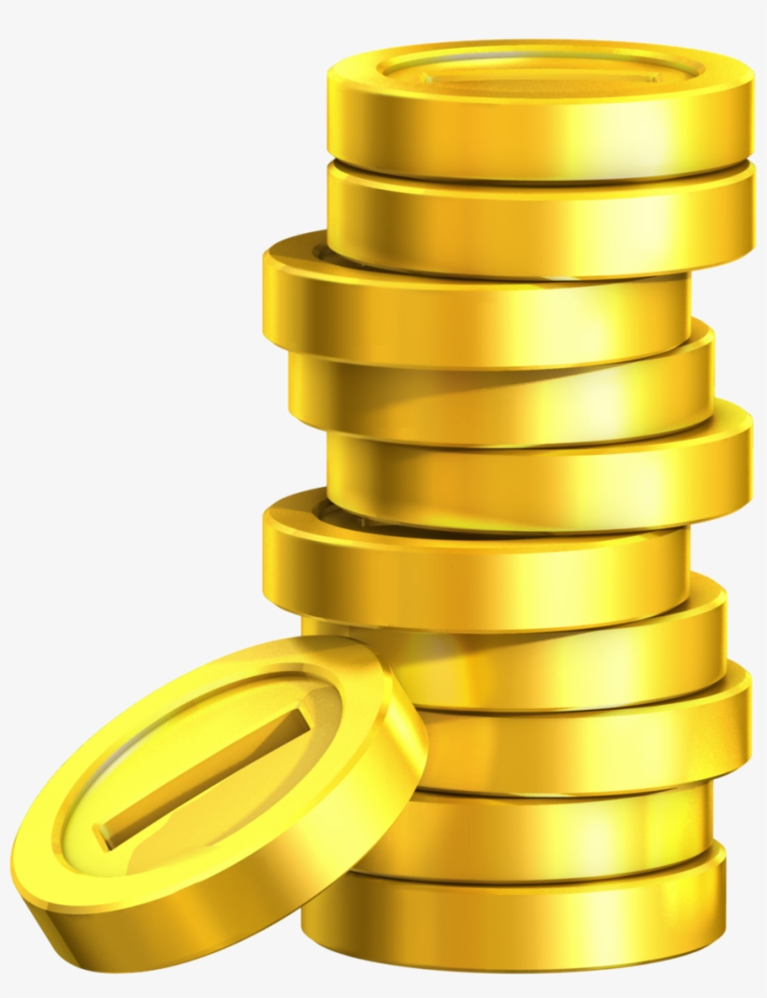
Sports gambling 101
DADF

Slide 3
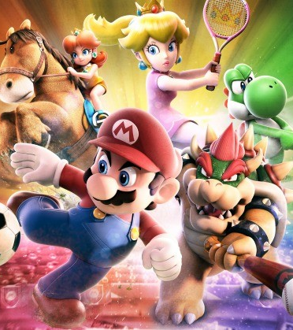
Final Inspiration
They be asking me,
“How Duke you feel?”
Imma step on you
With my Tarheel.
-DJ Mario

